Slide 1
Project Plan: 20 Questions
Wellesley Boboc, Anna-Janina Goecke, Rodrigo Lopez Portillo Alcocer, Elizabeth Pankratz
June 30, 2020
PM1 Question Processing
Universität Potsdam, MSc Cognitive Systems, Summer 2020

Slide 2
20 Questions Game

Slide 3
Task
Human player thinks of target object
System strategically generates and asks yes/no questions to narrow down candidates in knowledge base
Goal: Correctly guess target object in fewer than 20 questions
If target object is not already in knowledge base, add new entry

Slide 4
Motivation
Generate natural language questions about different features
Manipulate knowledge base according to user inputs
Grow knowledge base over successive plays

Slide 5
Related Work
20 Questions
Probabilistic Models
Dey et al. (2019)
Reinforcement learning
Hu et al. (2018)
Neural Networks
Reddy et al. (2017)
Burgener (2006)
Tonin et al. (2018)
Rule-Based Question Generation
Mhatre et al. (2019)
Khullar et al. (2018)

Slide 6
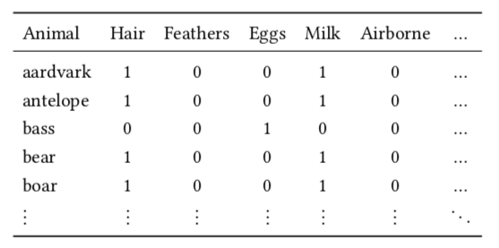
Implementation
Preliminary knowledge base (100 objects, 28 features)
Final knowledge base should have many more features, wider range of objects
Implementation of Decision Tree/CART Model
Recursively partitions knowledge base based on user’s answers
Partition that splits database most evenly (50/50) used to choose next question ( = highest information gain)
Notes:
CART = classification and regression tree

Slide 7
DEMO

Slide 8
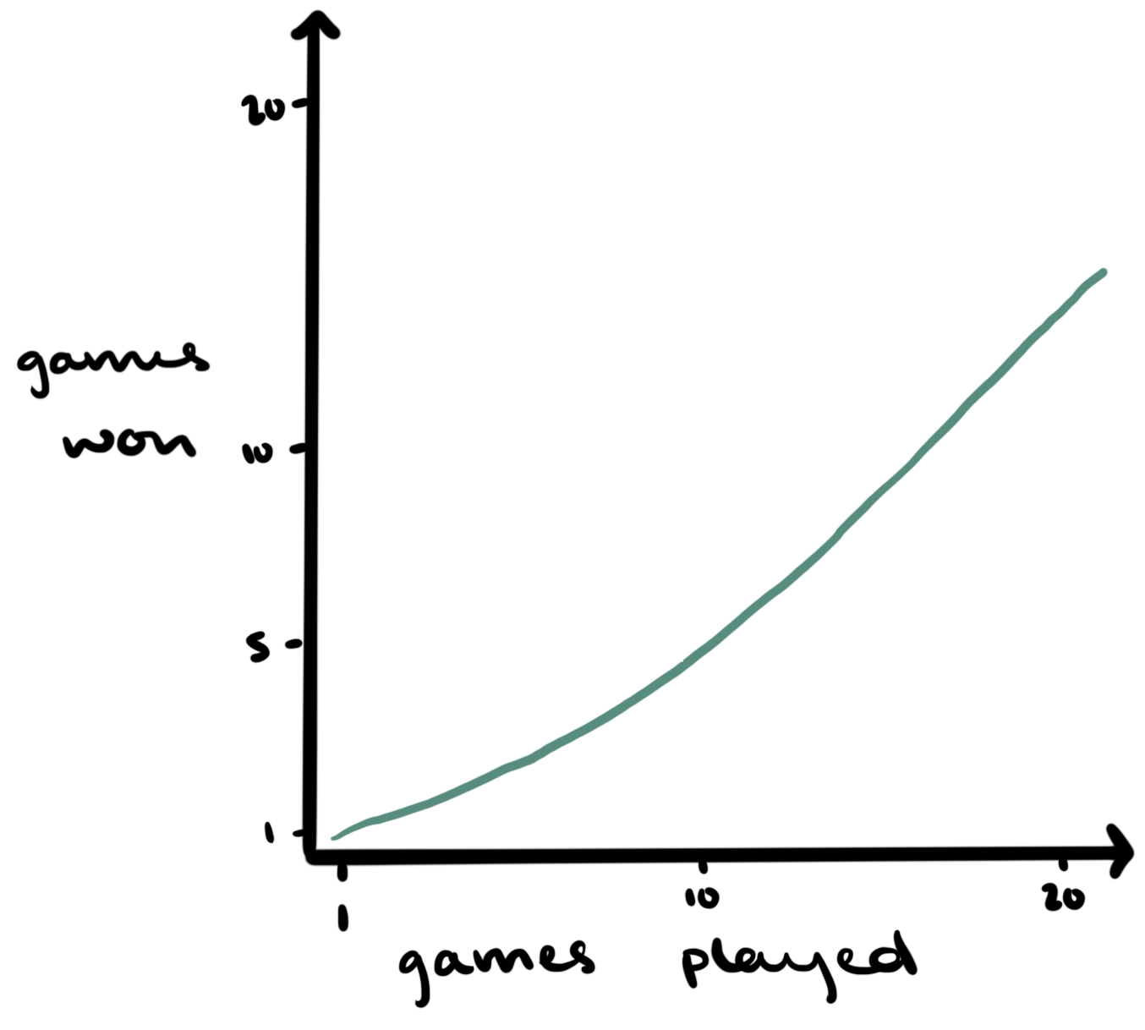
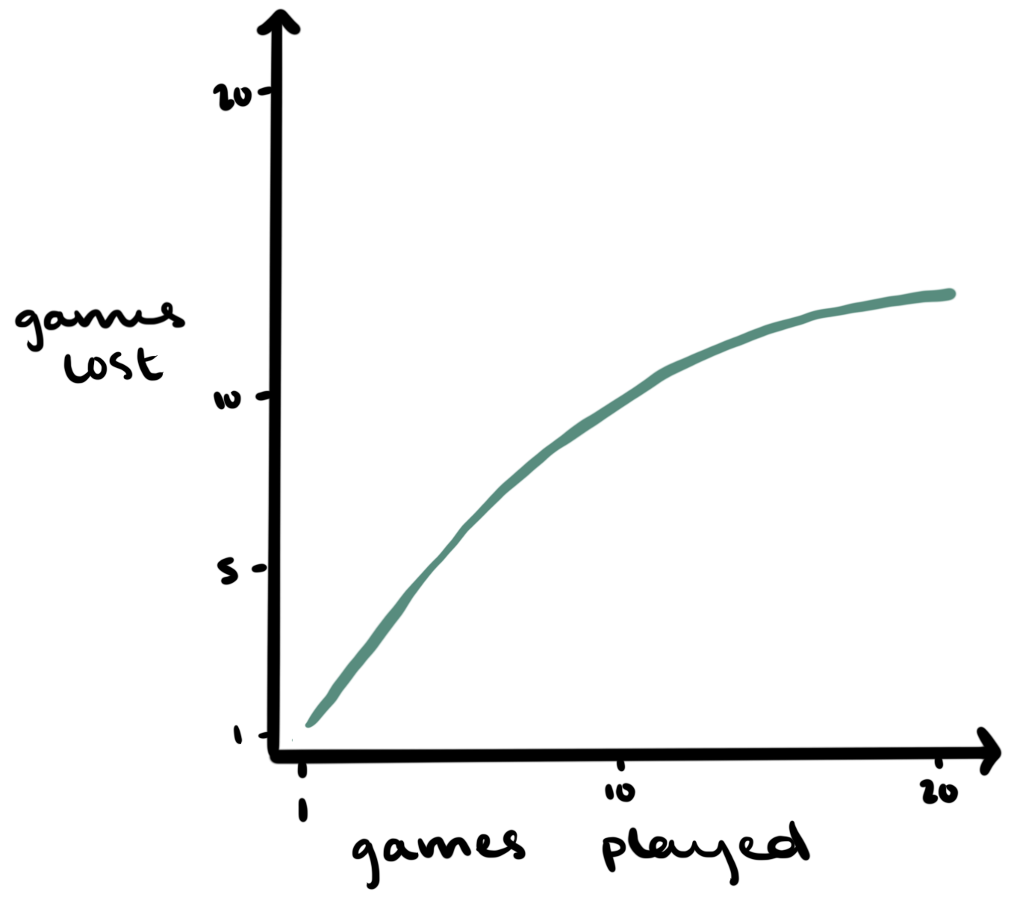
Evaluation
Win/loss rate
# of questions needed to win?
How many wins/losses exceeded 20Q limit?
How many wins/losses from out of database items?
How well does the system interpolate for features? (compare to manual annotation)

Slide 9
Considerations & Next Steps
Improve dataset/knowledge base
spaCy vs. other methods for question generation (WordNet, Switchboard Corpus)
Handling wrong/inconsistent answers, cultural/demographic differences
Answer weights/degrees of certainty
Feature dependency/co-occurrence

Slide 10
References
Burgener, Robin. 2006. Artificial neural network guessing method and game. US Patent App. 11/102,105. Dey, Alvin, Harsh Kumar Jain, Vikash Kumar Pandey & Tanmoy Chakraborty. 2019. All it takes is 20 Questions!: A knowledge graph based approach. arXiv preprint arXiv:1911.05161.
Hu, Huang, Xianchao Wu, Bingfeng Luo, Chongyang Tao, Can Xu, Wei Wu & Zhan Chen. 2018. Playing 20 question game with policy-based reinforcement learning. arXiv preprint arXiv:1808.07645.
Khullar, Payal, Konigari Rachna, Mukul Hase & Manish Shrivastava. 2018. Automatic question generation using relative pronouns and adverbs. In Proceedings of acl 2018, student research workshop, 153–158. Mhatre, Kaksha, Akshada Thube, Hemraj Mahadeshwar & Avinash Shrivas. 2019. Question generation using NLP. International Journal of Scientific Research & Engineering Trends 5(2). 394–397. Reddy, Sathish, Dinesh Raghu, Mitesh M. Khapra & Sachindra Joshi. 2017. Generating natural language question-answer pairs from a knowledge graph using a RNN based question generation model. In Proceedings of the 15th conference of the European chapter of the Association for Computational Linguistics: Volume 1, long pa- pers, 376–385. Valencia, Spain: Association for Computational Linguistics. https://www.aclweb.org/anthology/E17-1036.
Tonin, Alessandro, Niels Birbaumer & Ujwal Chaudhary. 2018. A 20-questions-based binary spelling interface for communication systems. Brain sciences 8(7). 126.

